Slide 1
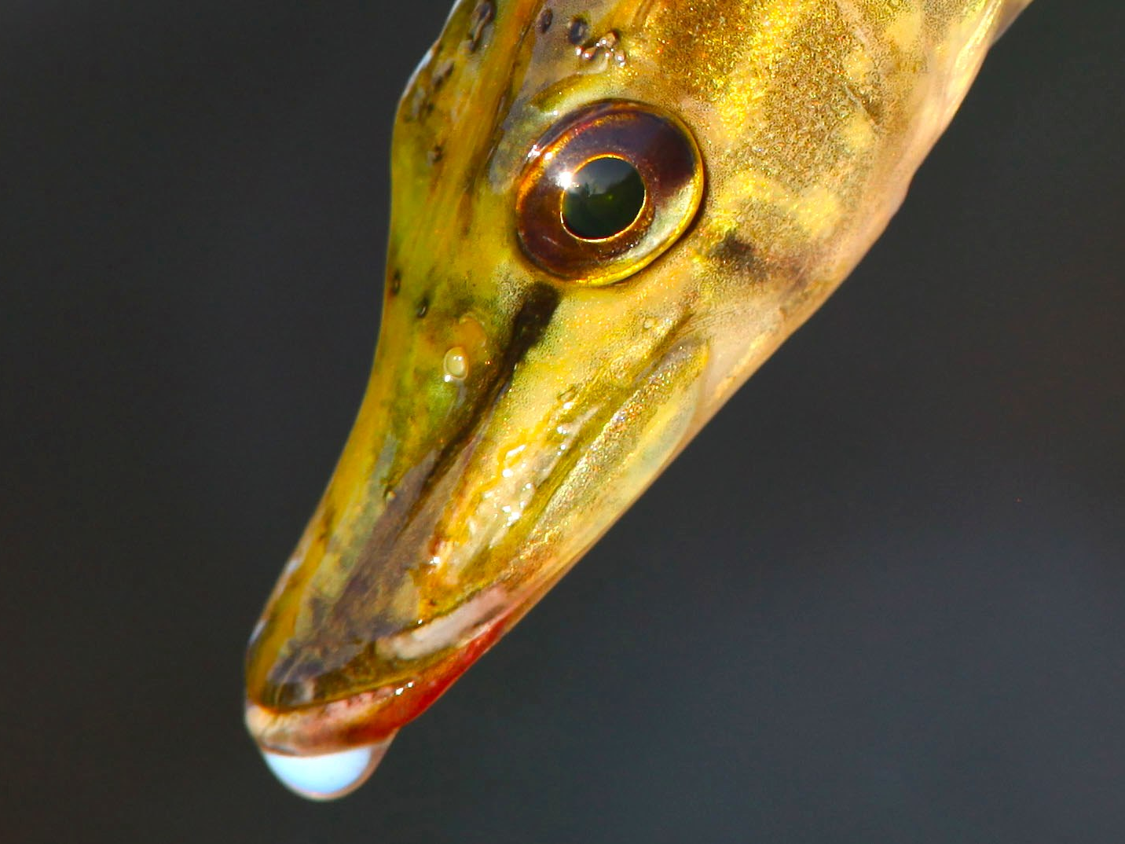
Making Finland a premier pike fishing destination
Steve rowley

Slide 2
BUT!
And it’s a very big but…

Slide 3
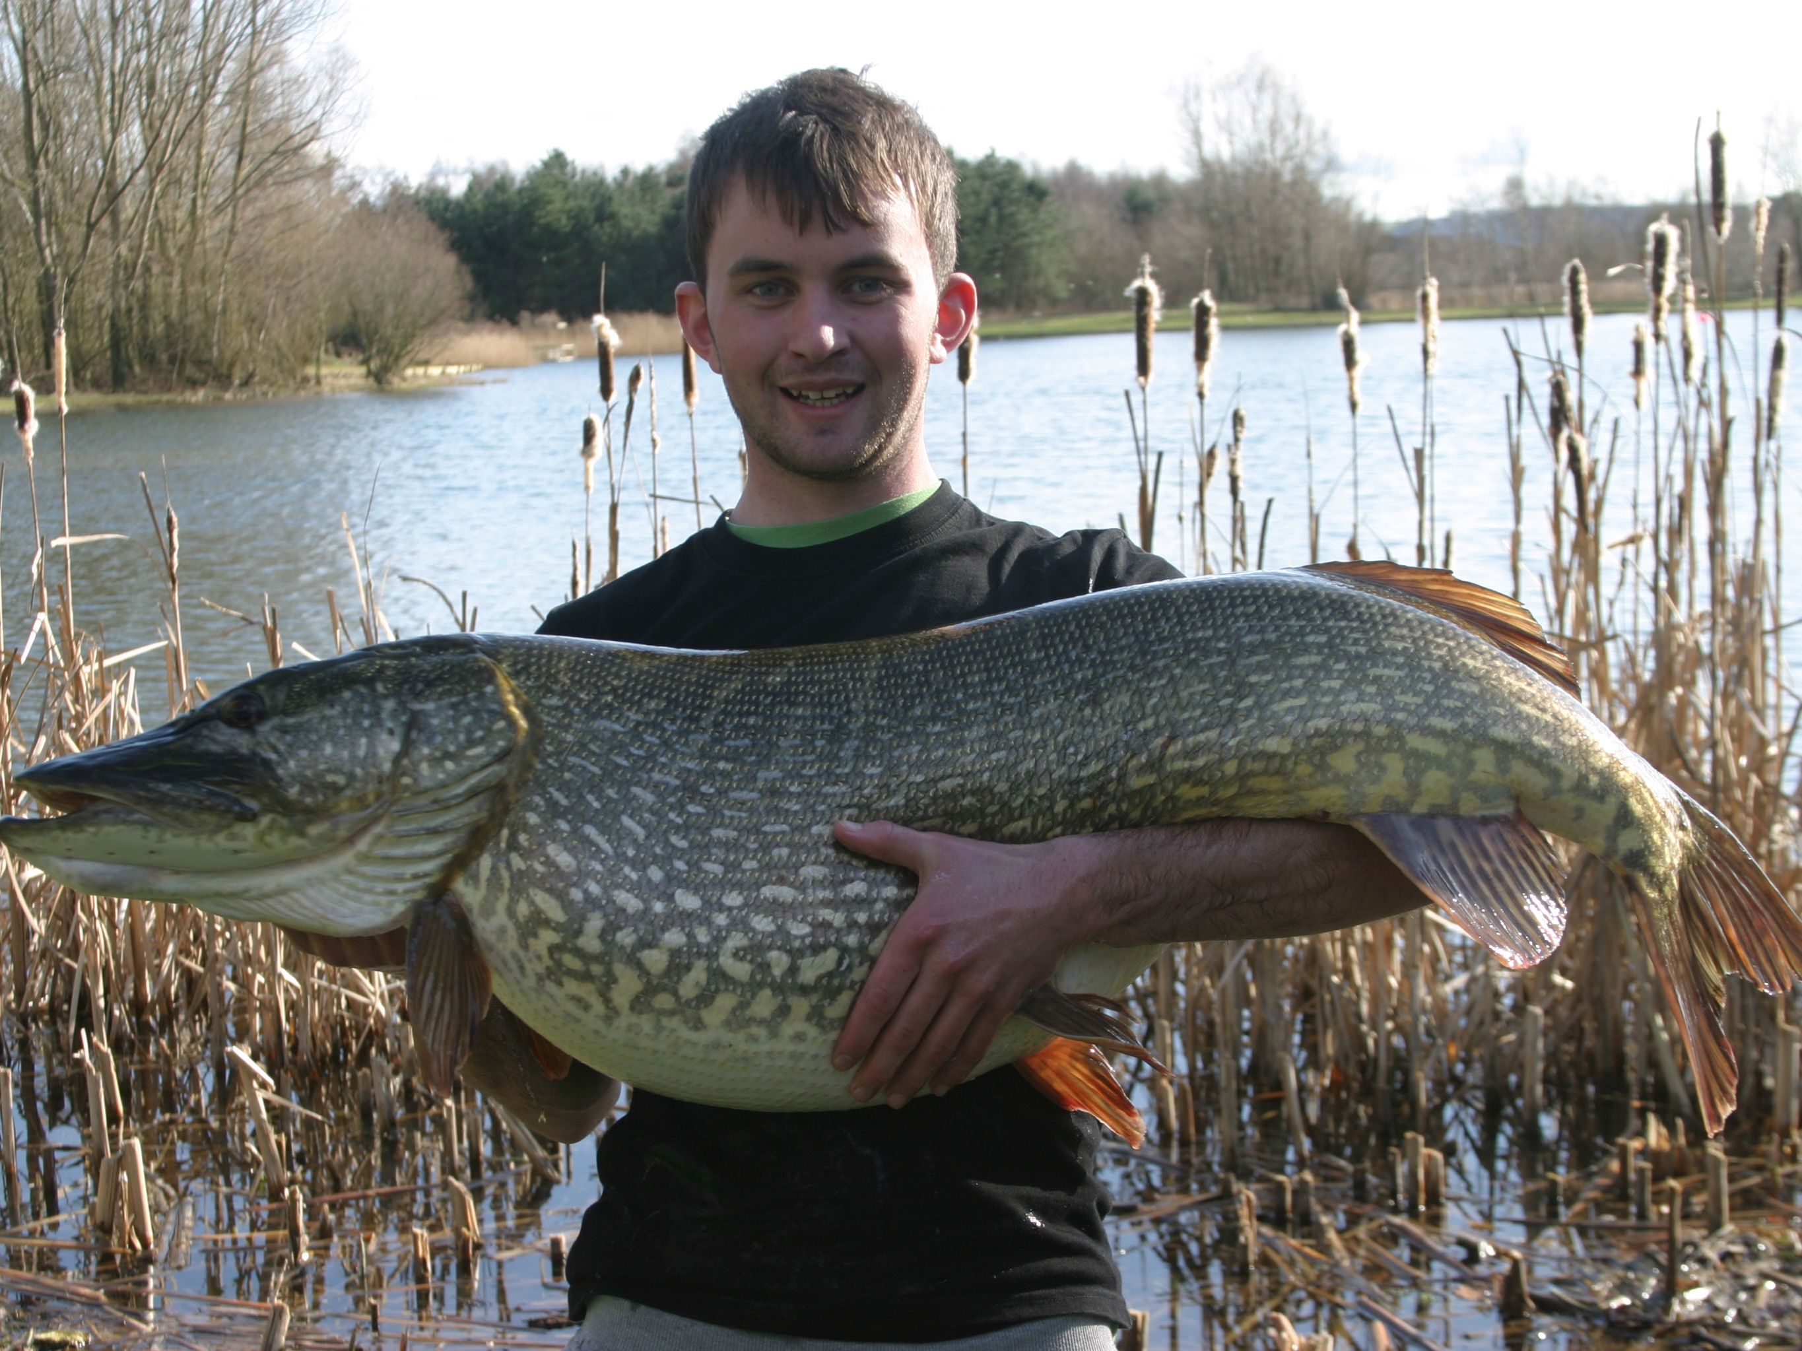

Slide 4
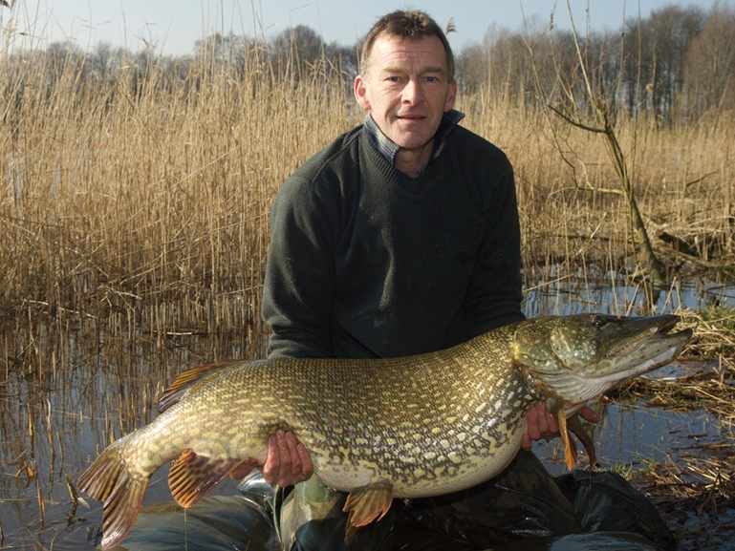

Slide 5
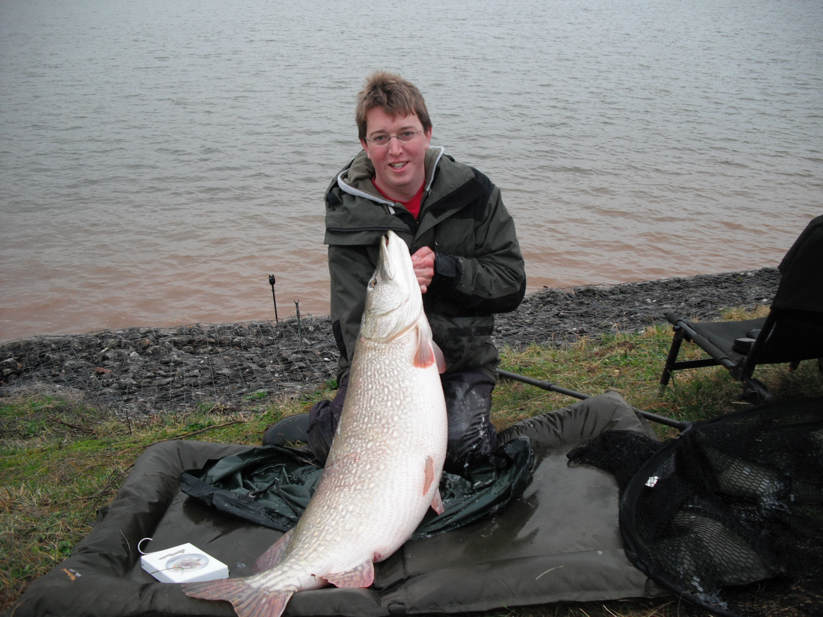

Slide 6
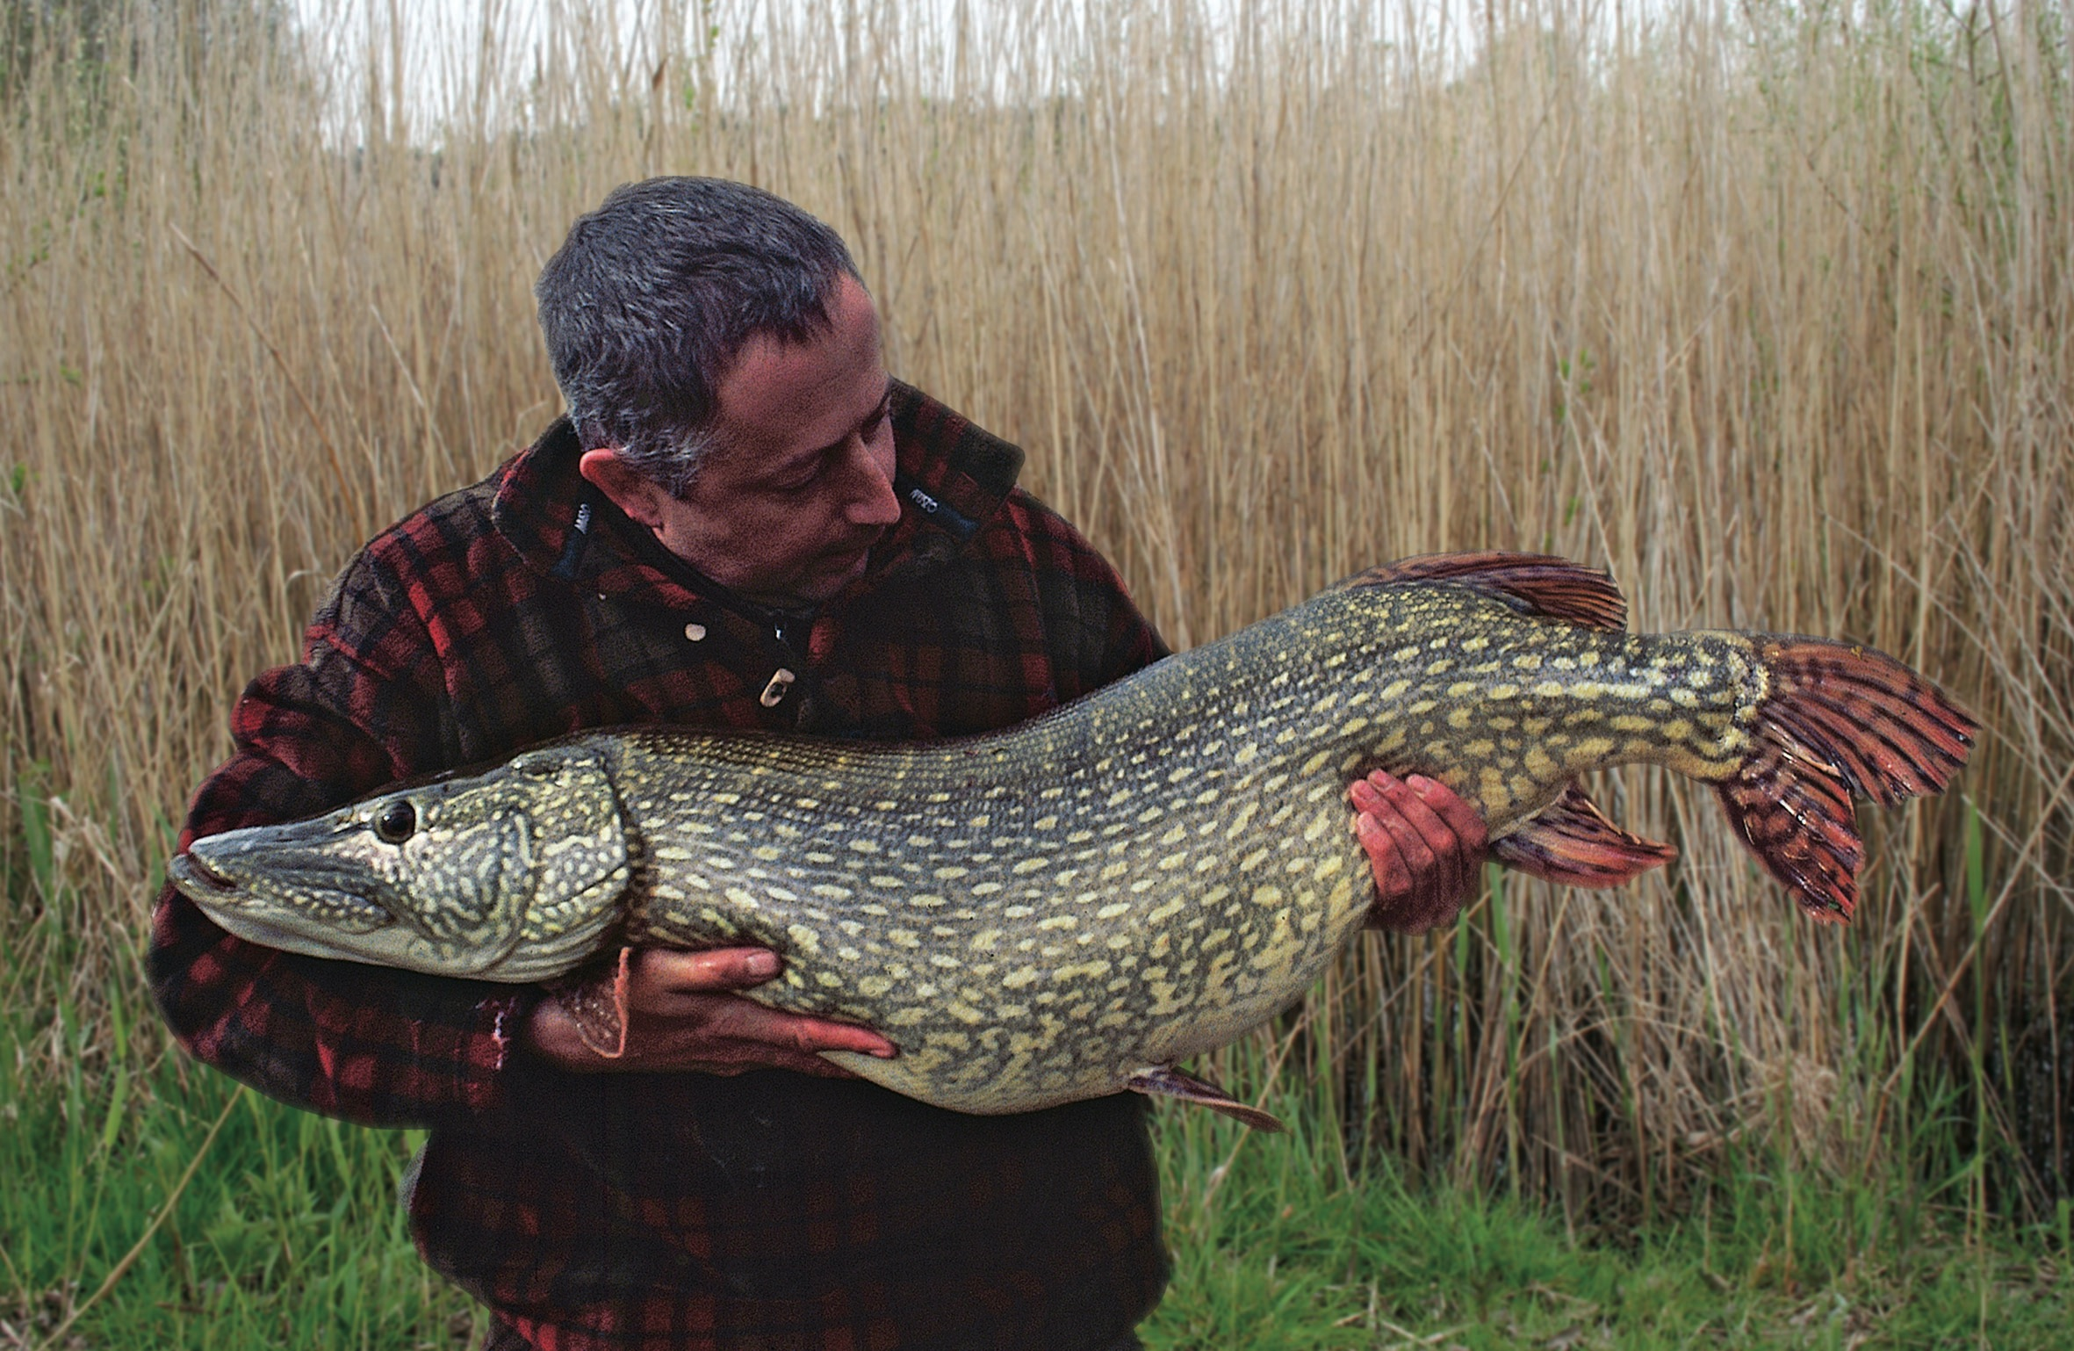

Slide 7
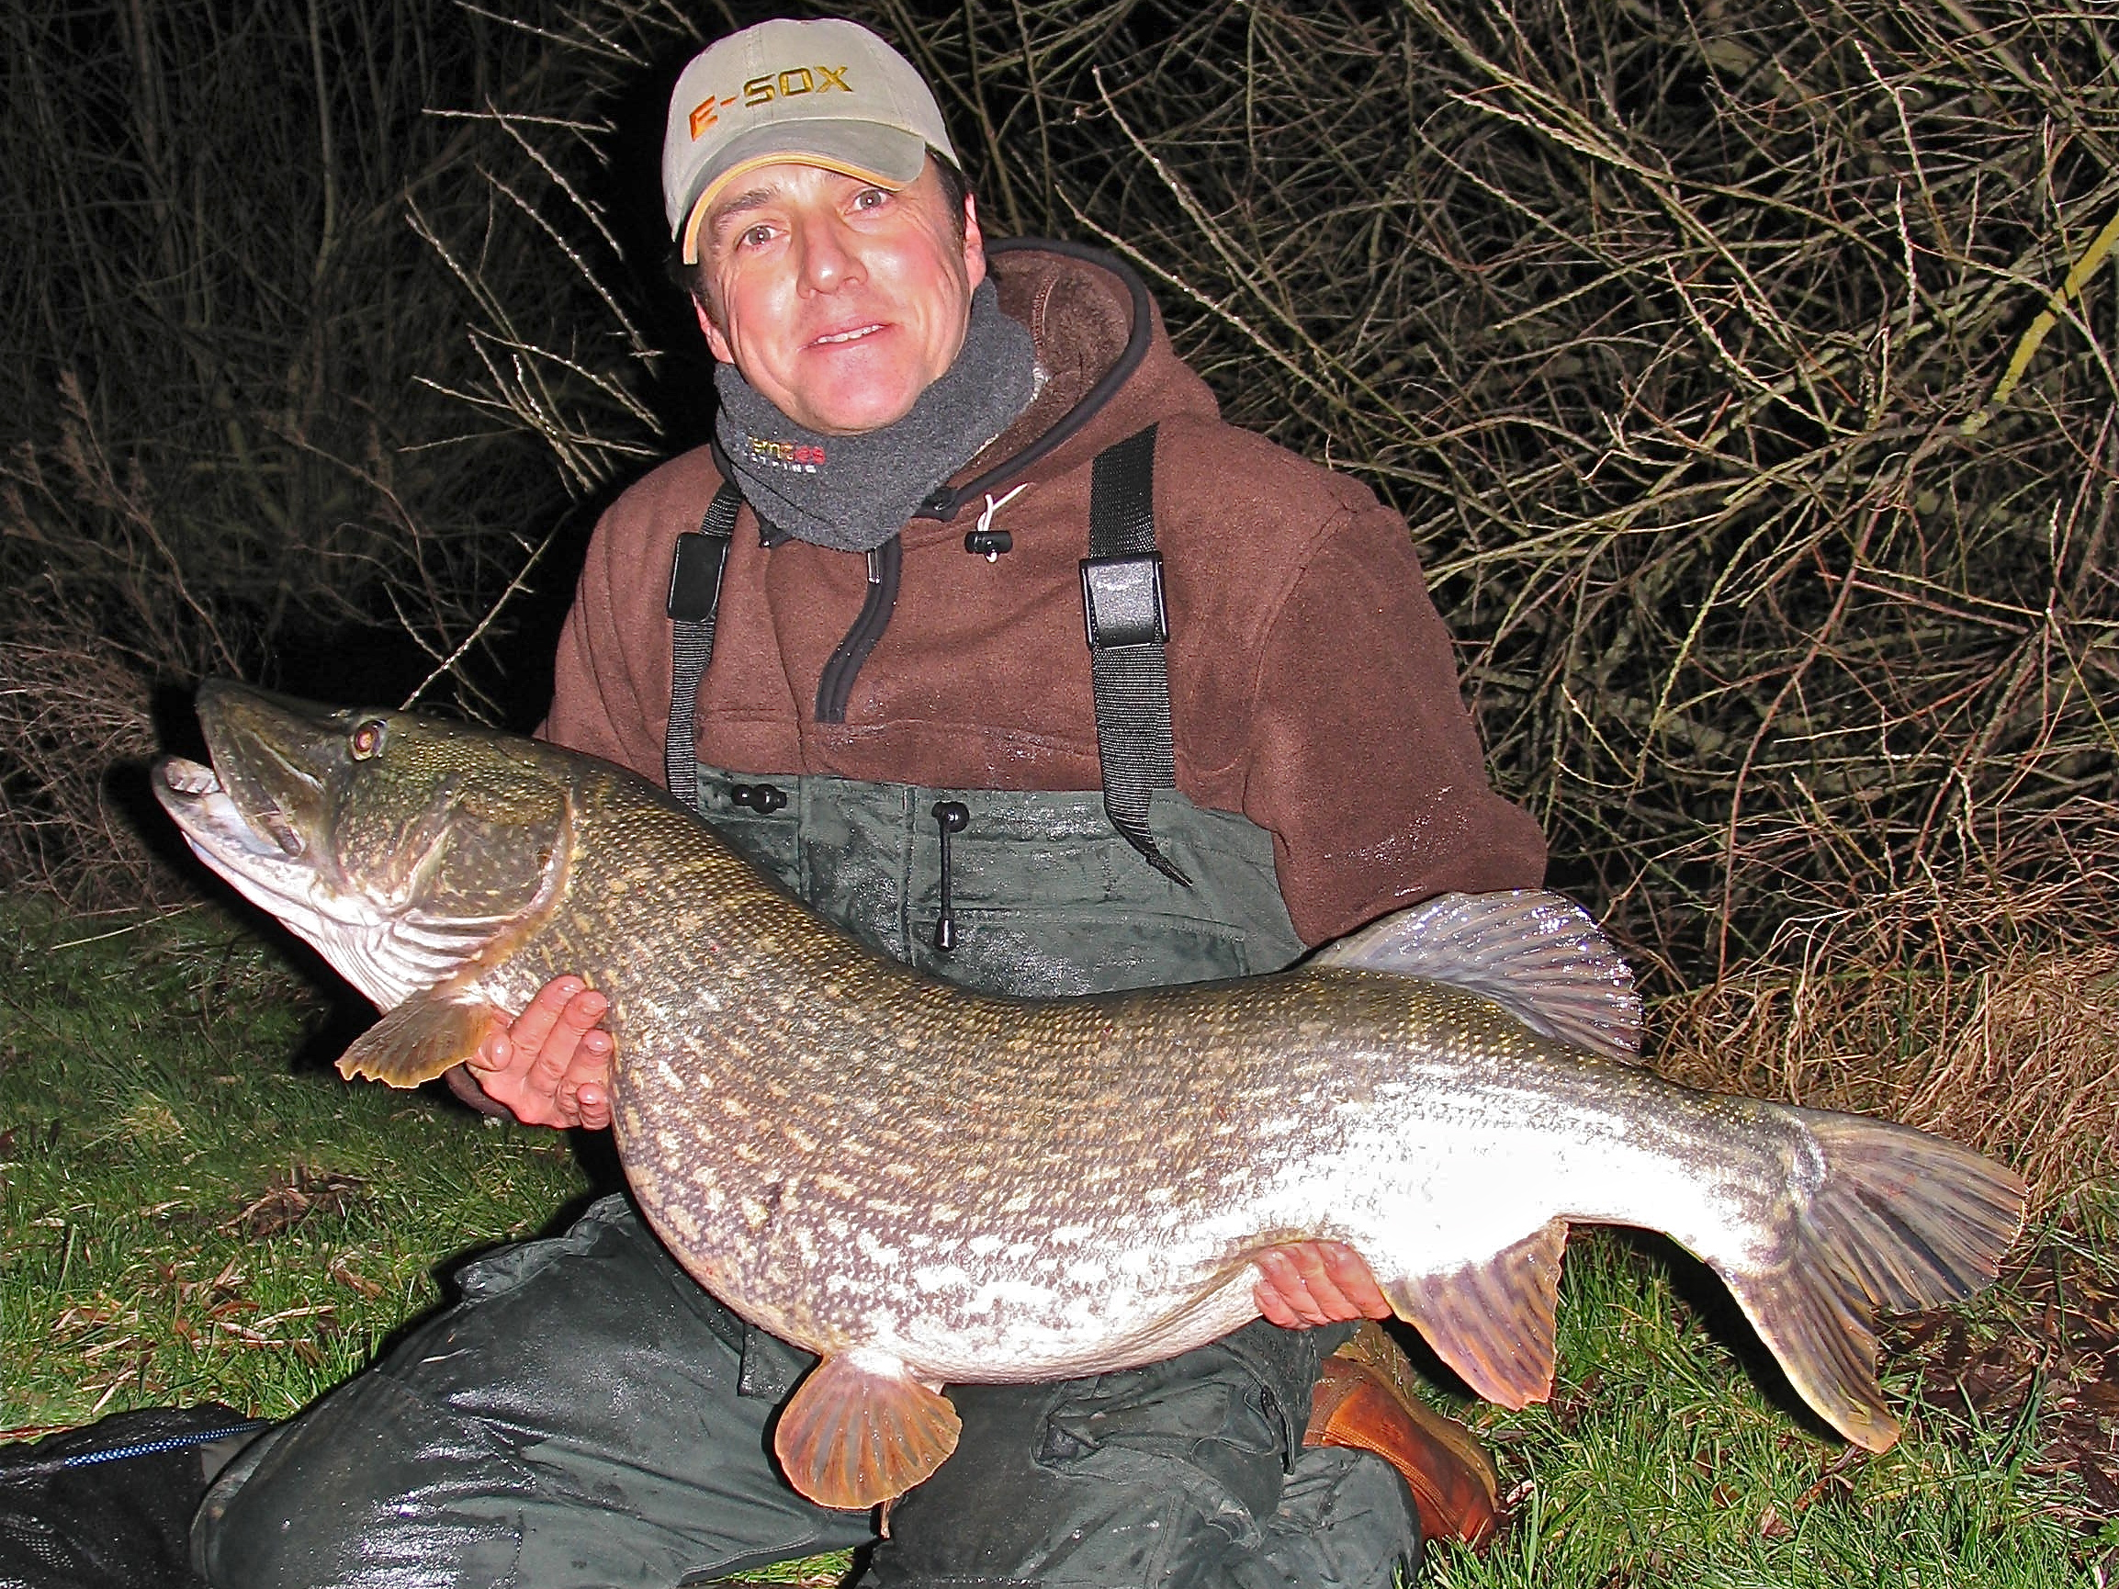

Slide 8
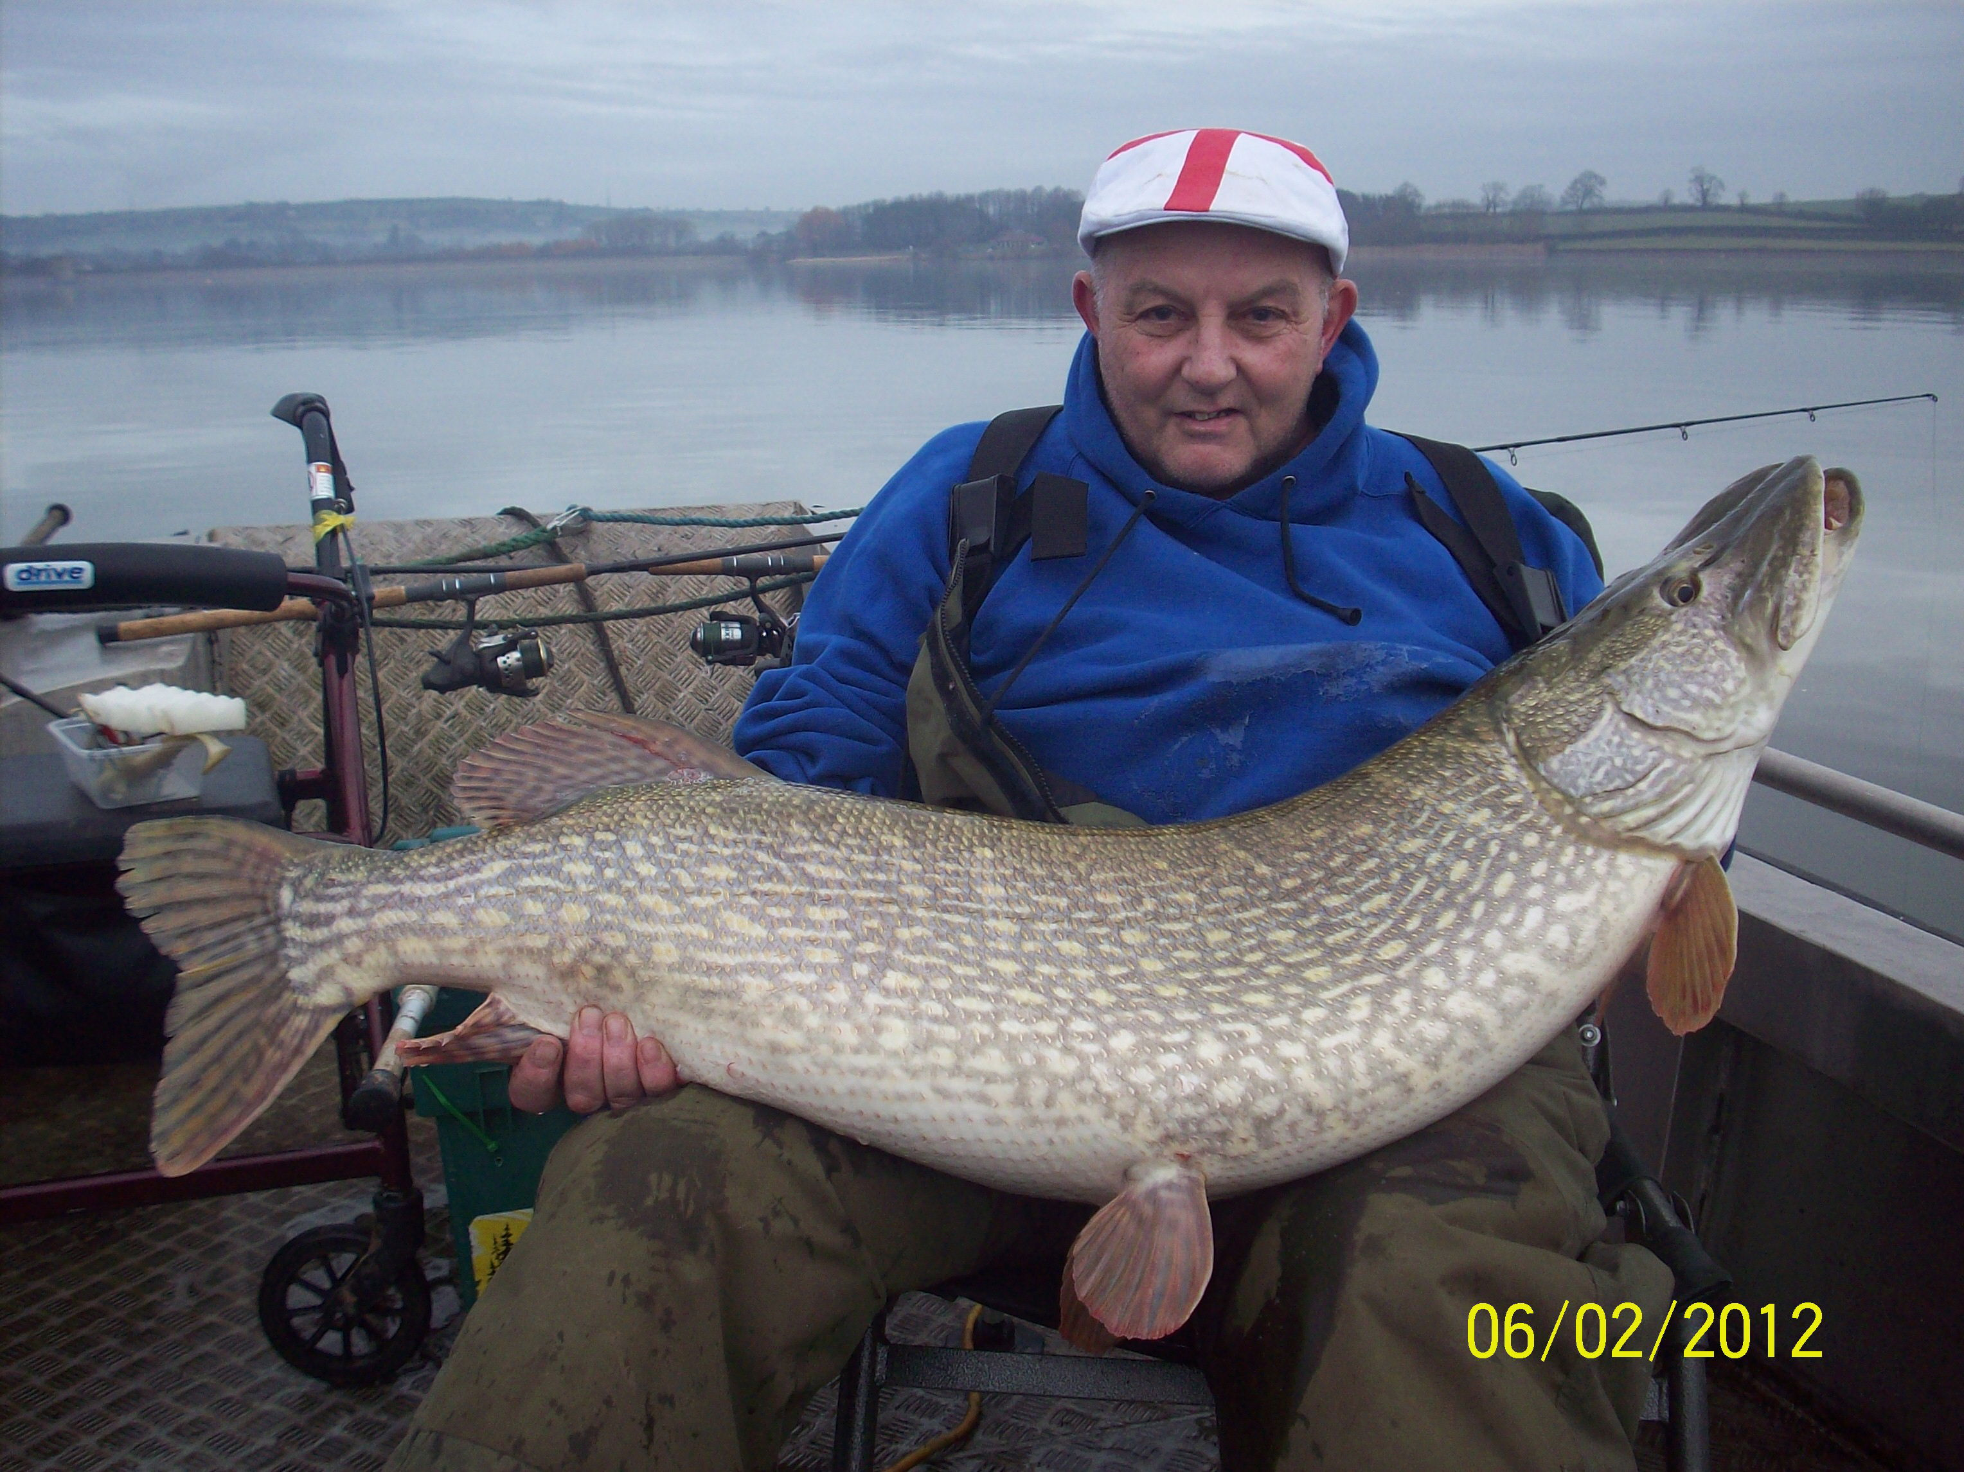

Slide 9
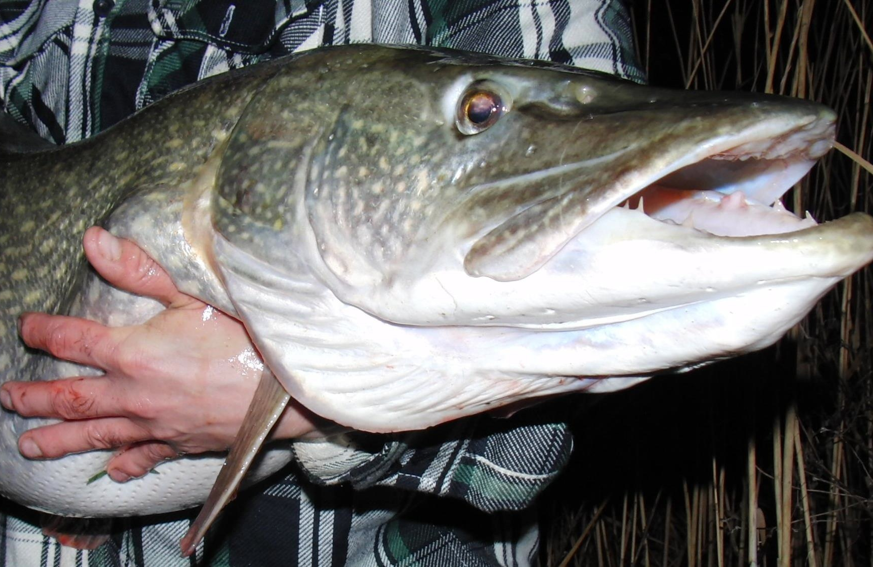

Slide 10
Want to catch a lot of pike.
Fish beautiful waters.
Great hospitality.
Want to catch monster pike!

Slide 11
Misconception

Slide 12
‘It’s Rock hard appearance’

Slide 14
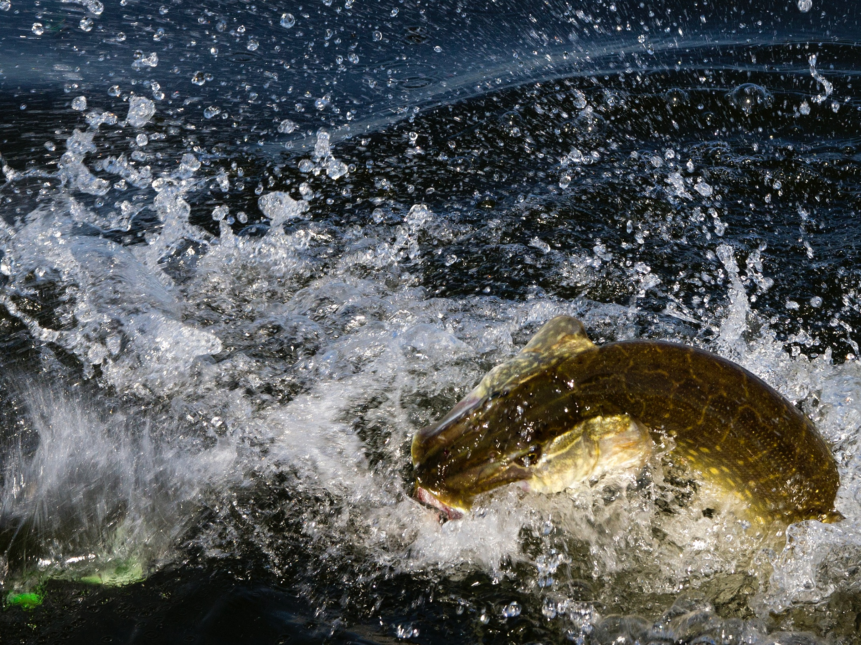

Slide 15
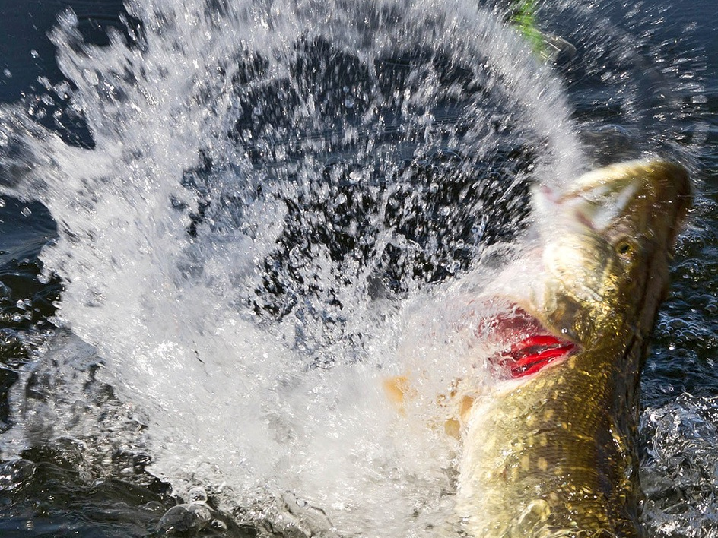

Slide 16
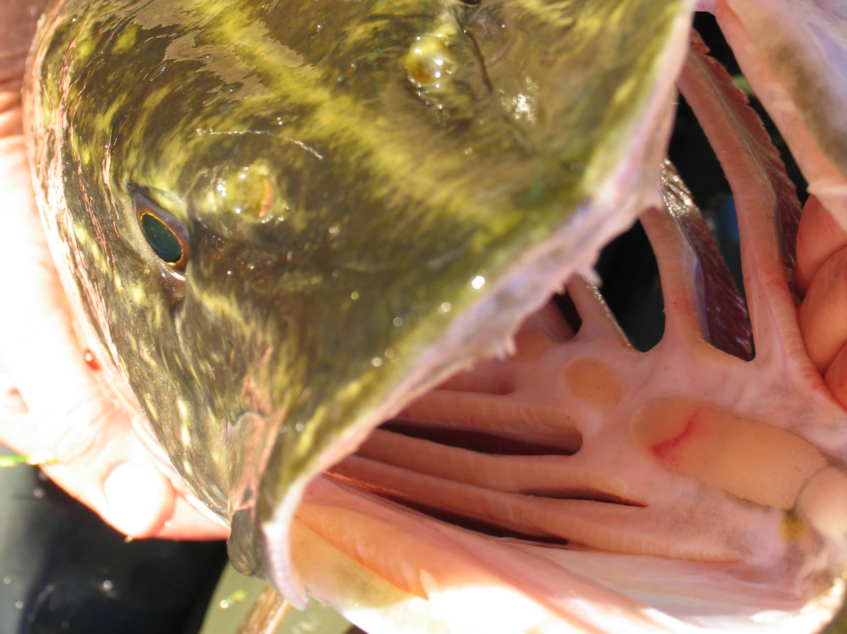

Slide 17
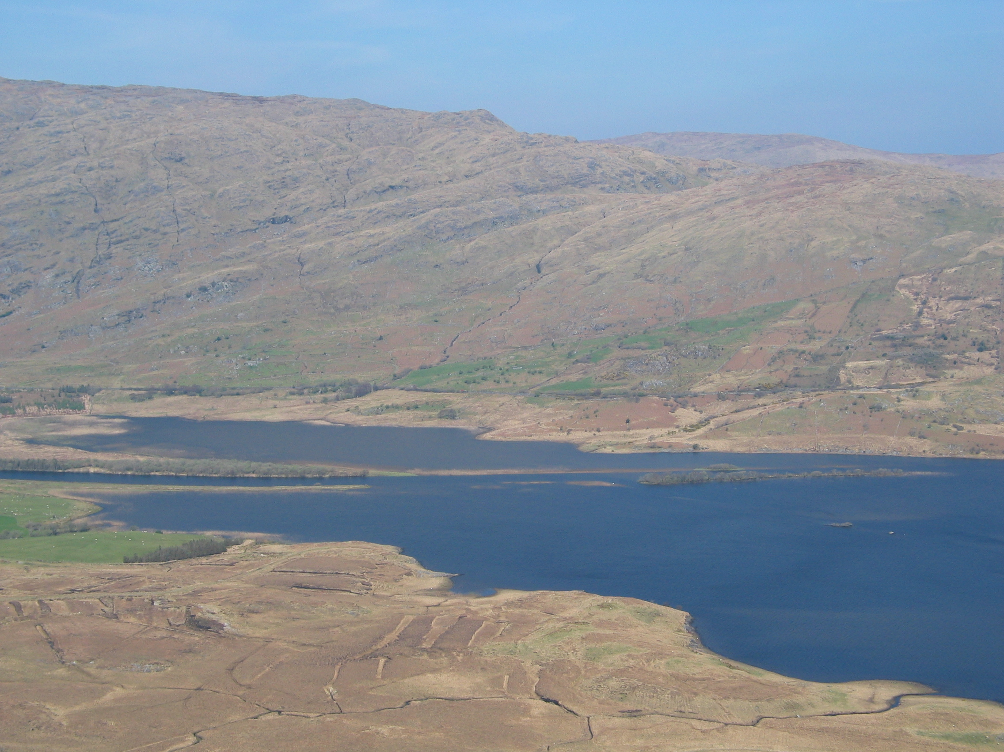

Slide 18
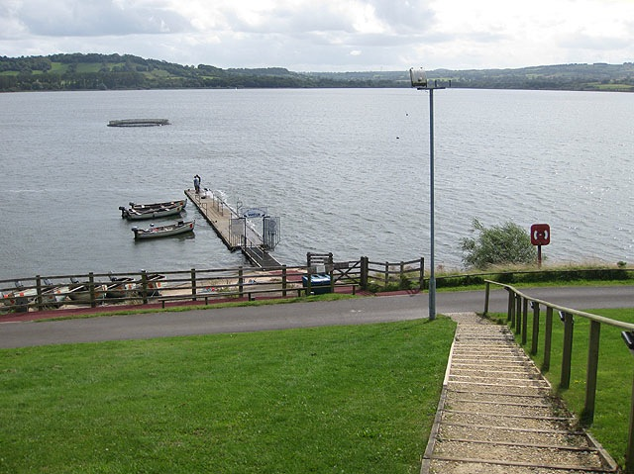

Slide 20
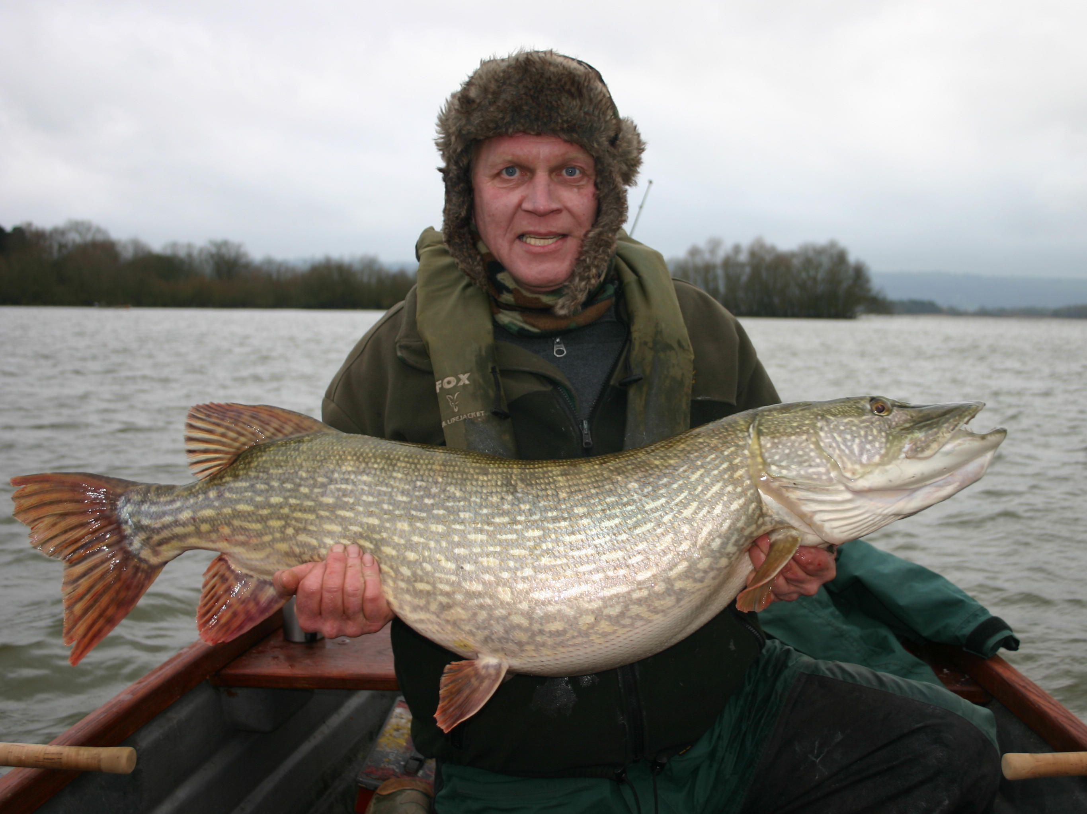

Slide 21
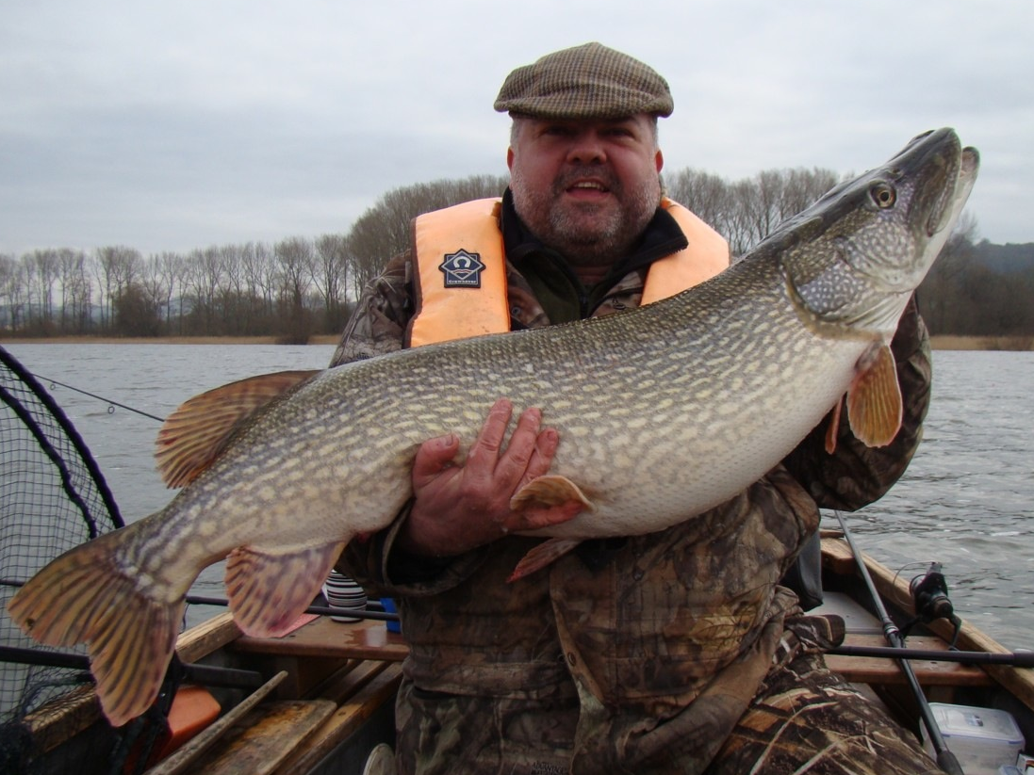

Slide 22
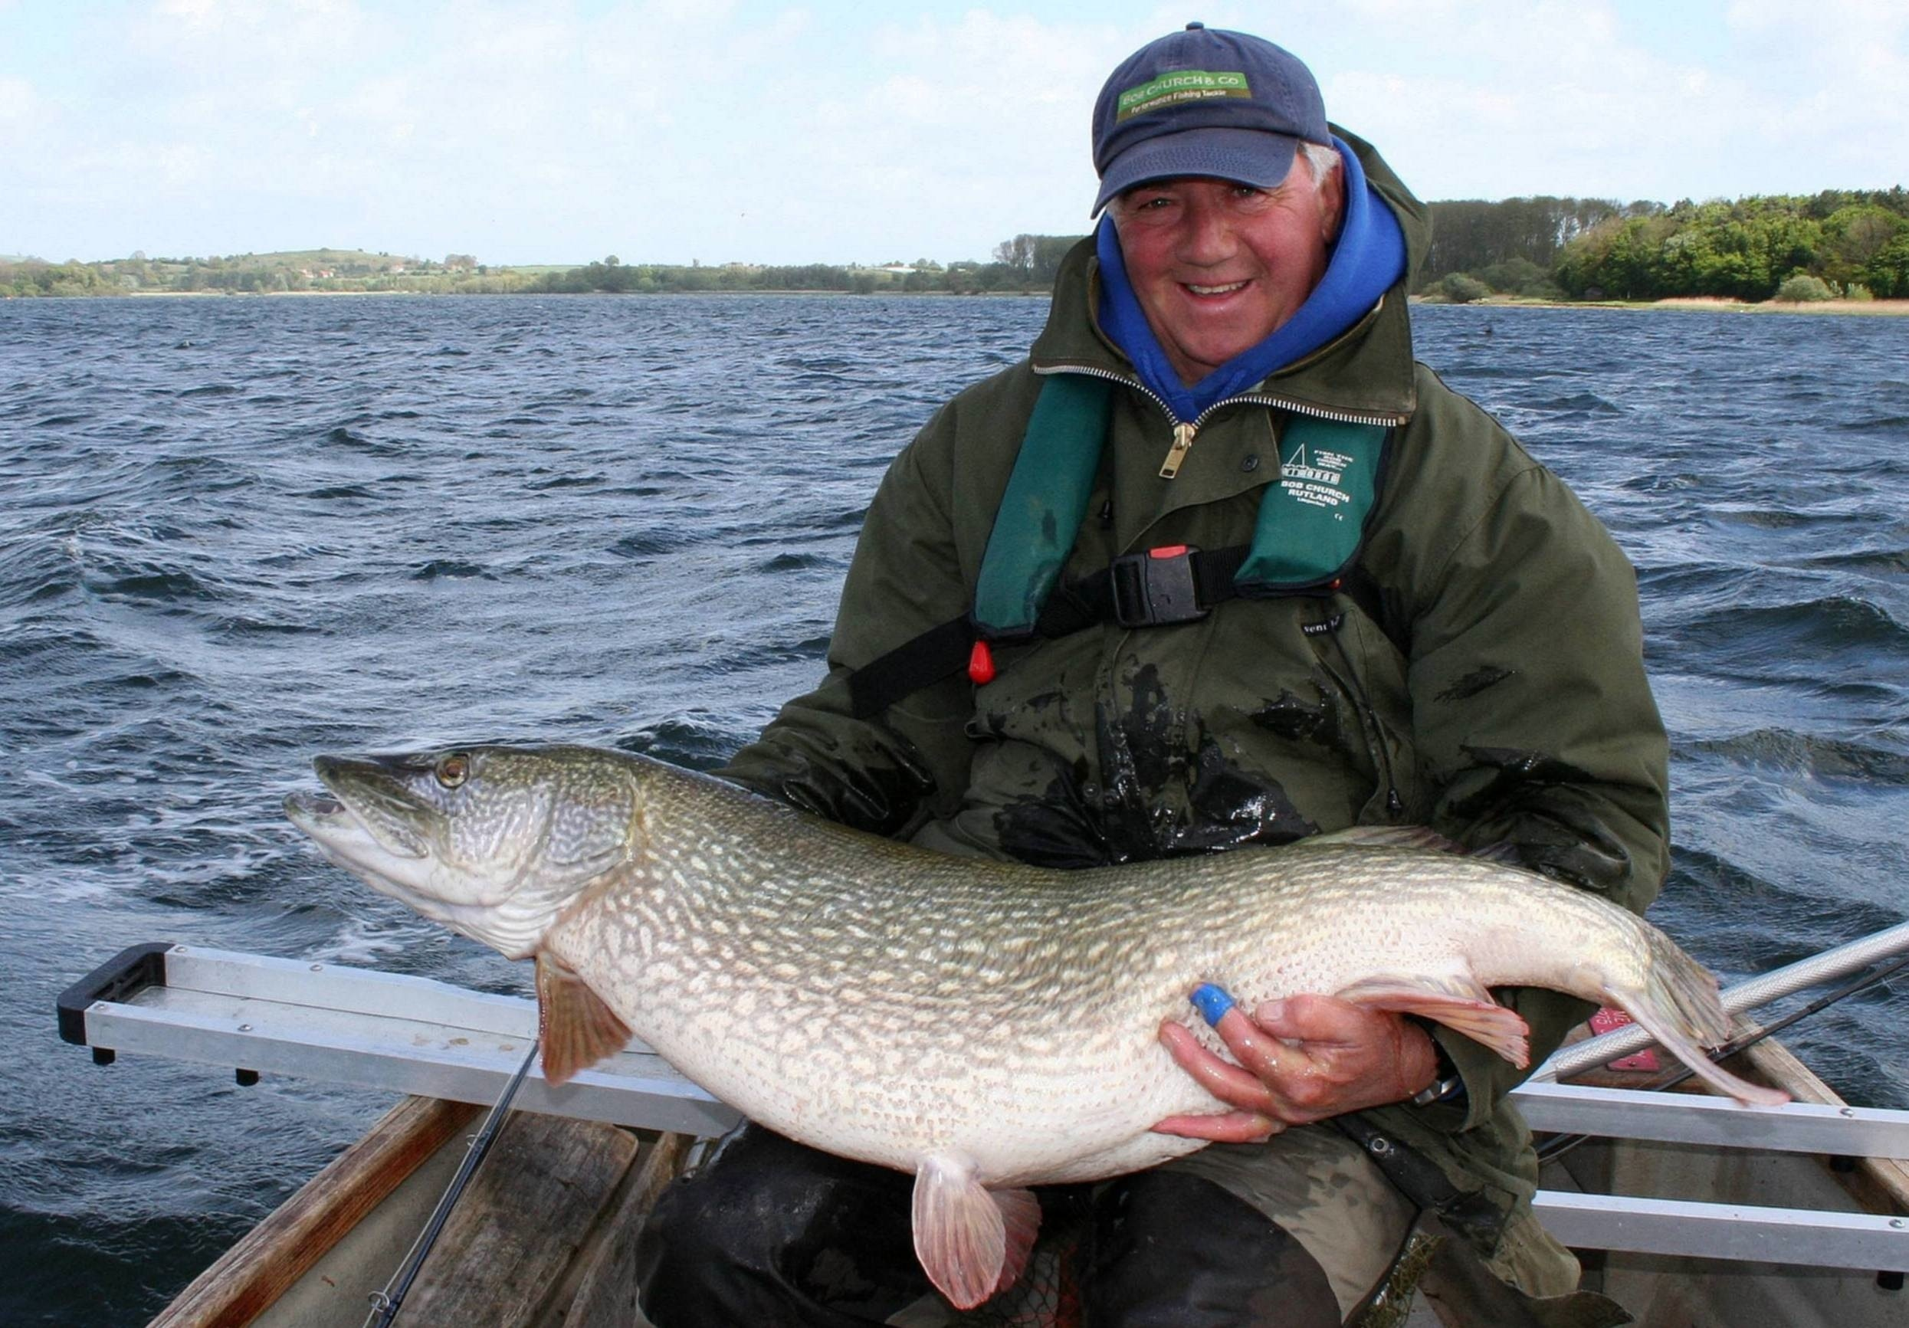

Slide 23
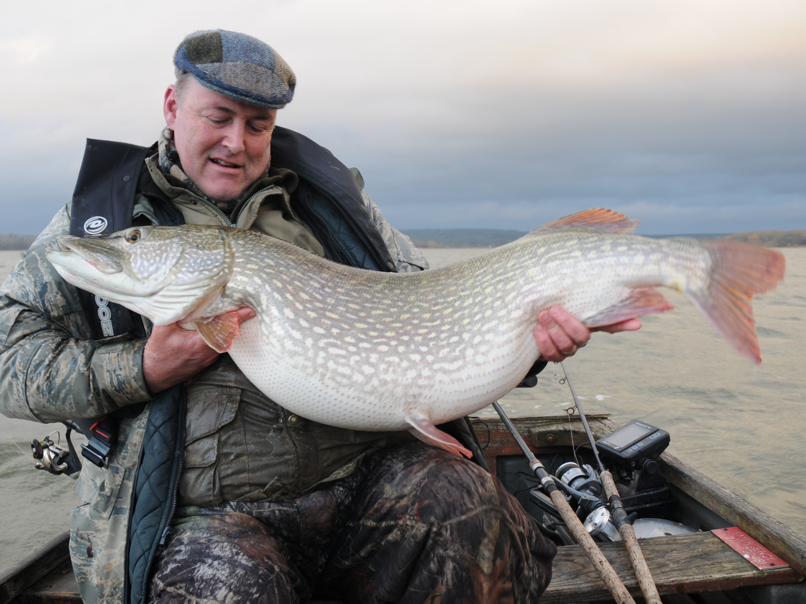

Slide 24
We understand what overseas pike anglers want - BIG pike!
That means 20lb and 30lb fish.
Misconception needs to be tackled at district level.
Kill any fish rule needs to be abolished!

Slide 25
Safe handling of your pike when caught

Slide 26
MAN!

Slide 27
PIKE ANGLERS!

Slide 28
“If you love pike that much, don’t fish for them”

Slide 30
Mission Statement
The Pike Angler’s Club of Great Britain will work to establish an environment in which pike are valued: both as a sporting fish and necessary part of the management and ecology of fresh waters.

Slide 31
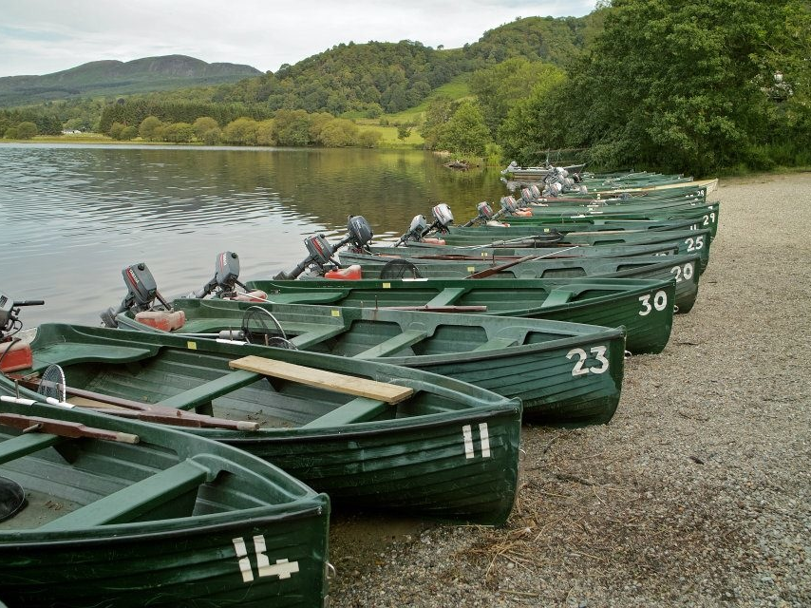

Slide 32
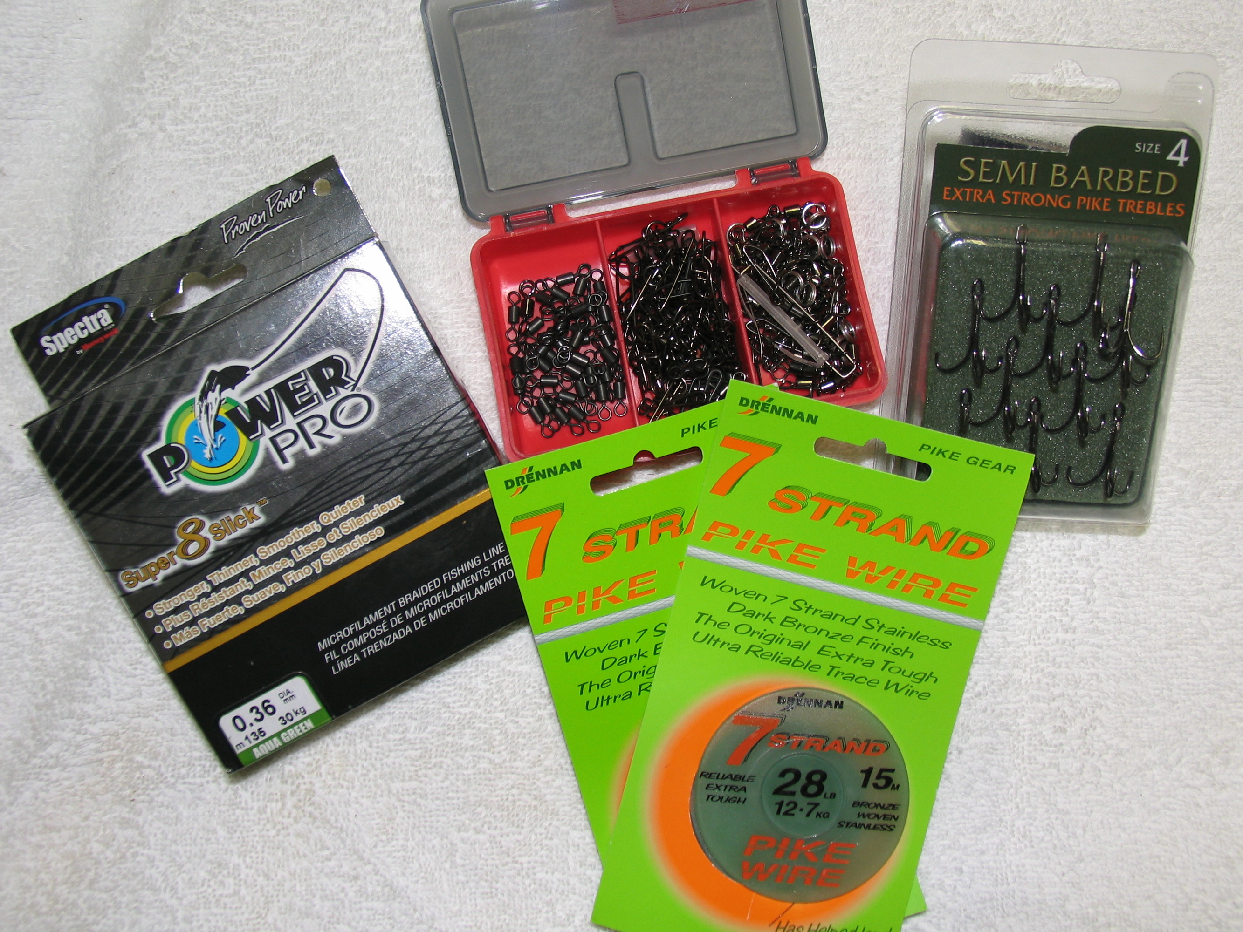

Slide 33
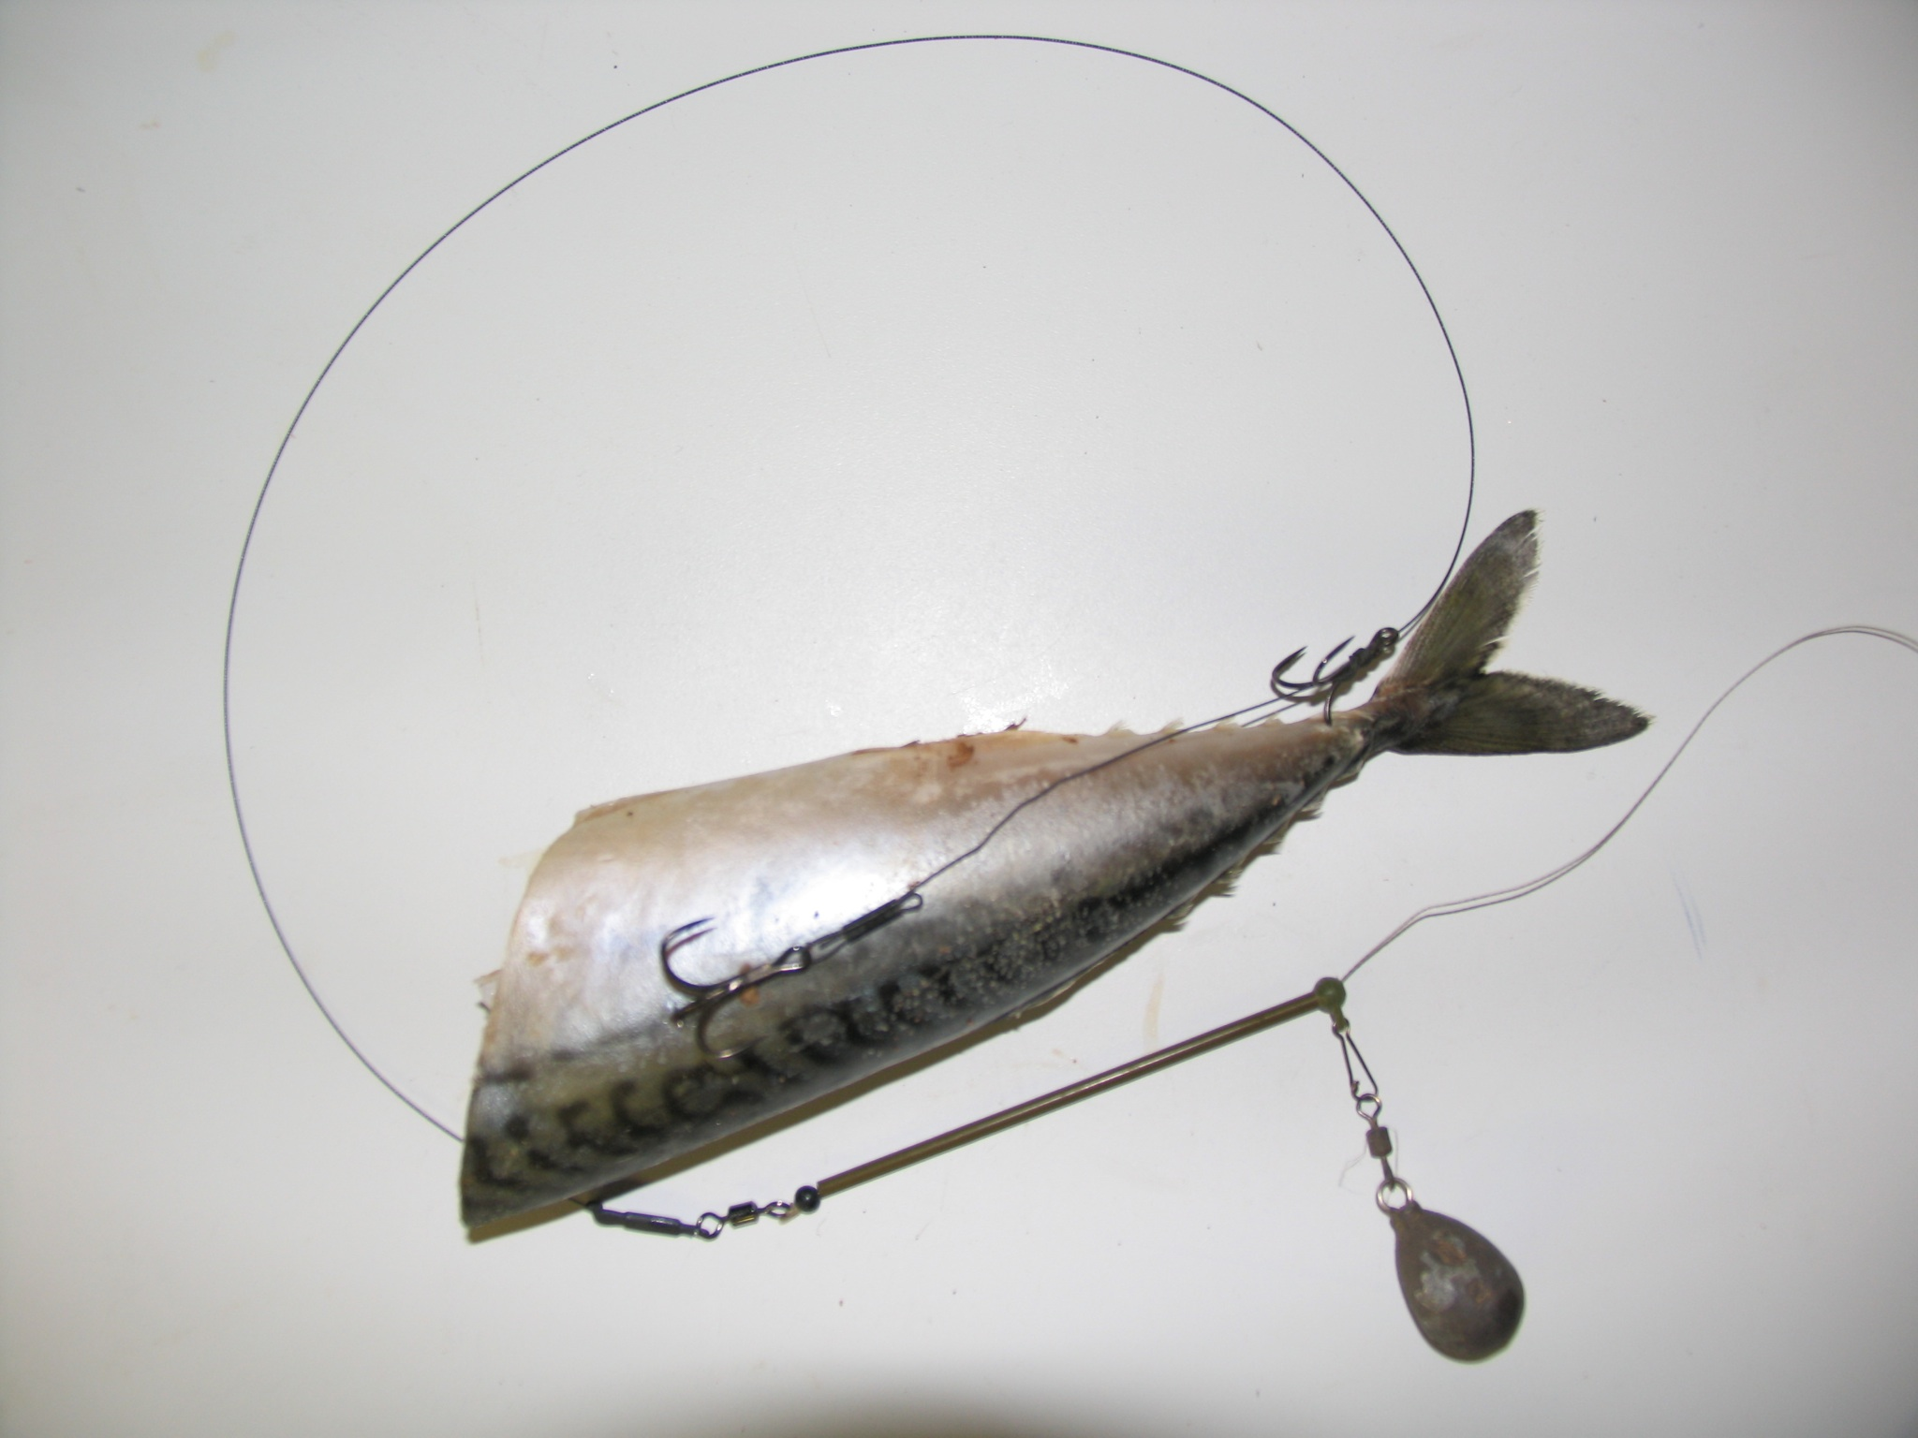

Slide 34
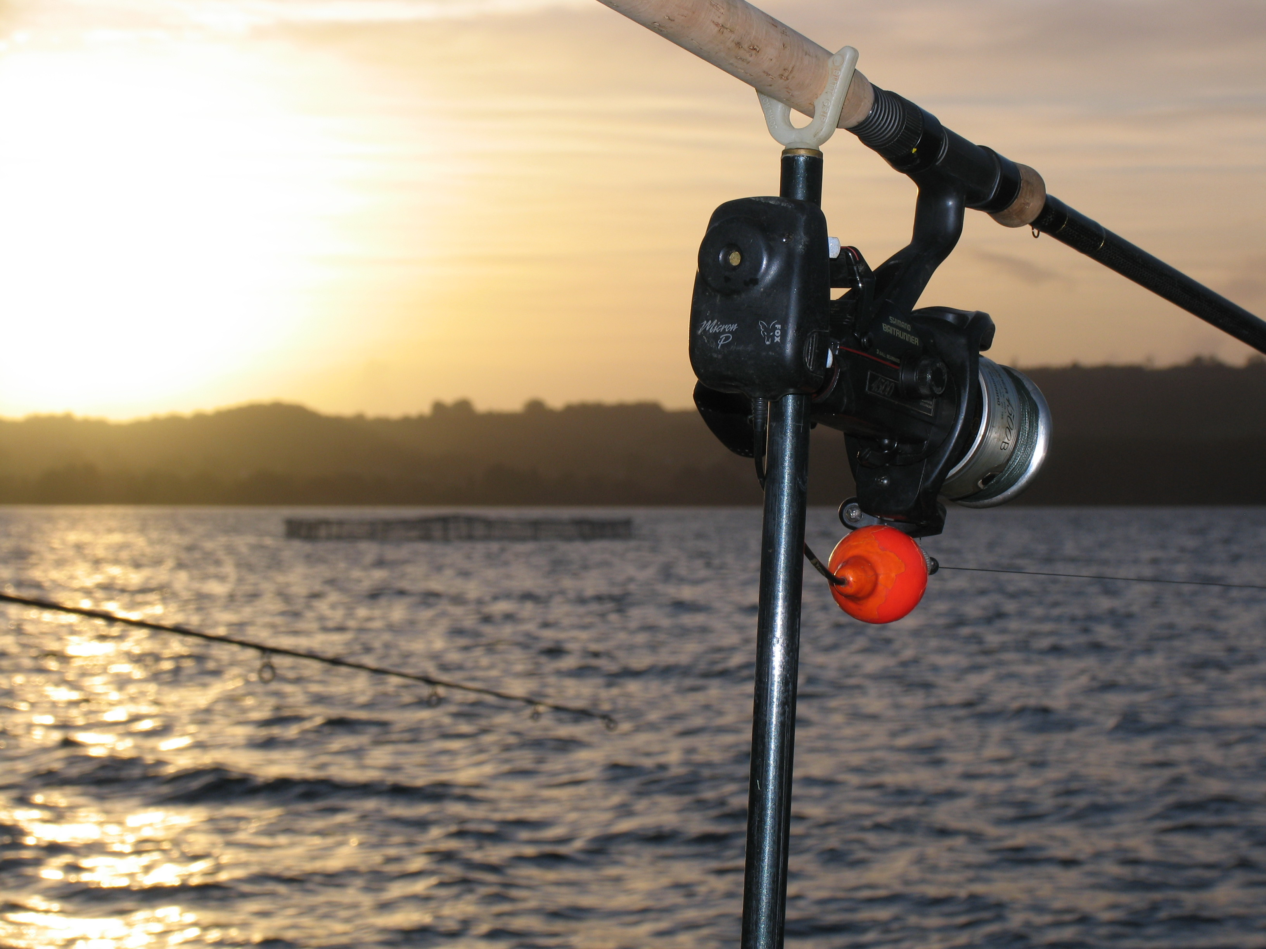

Slide 35
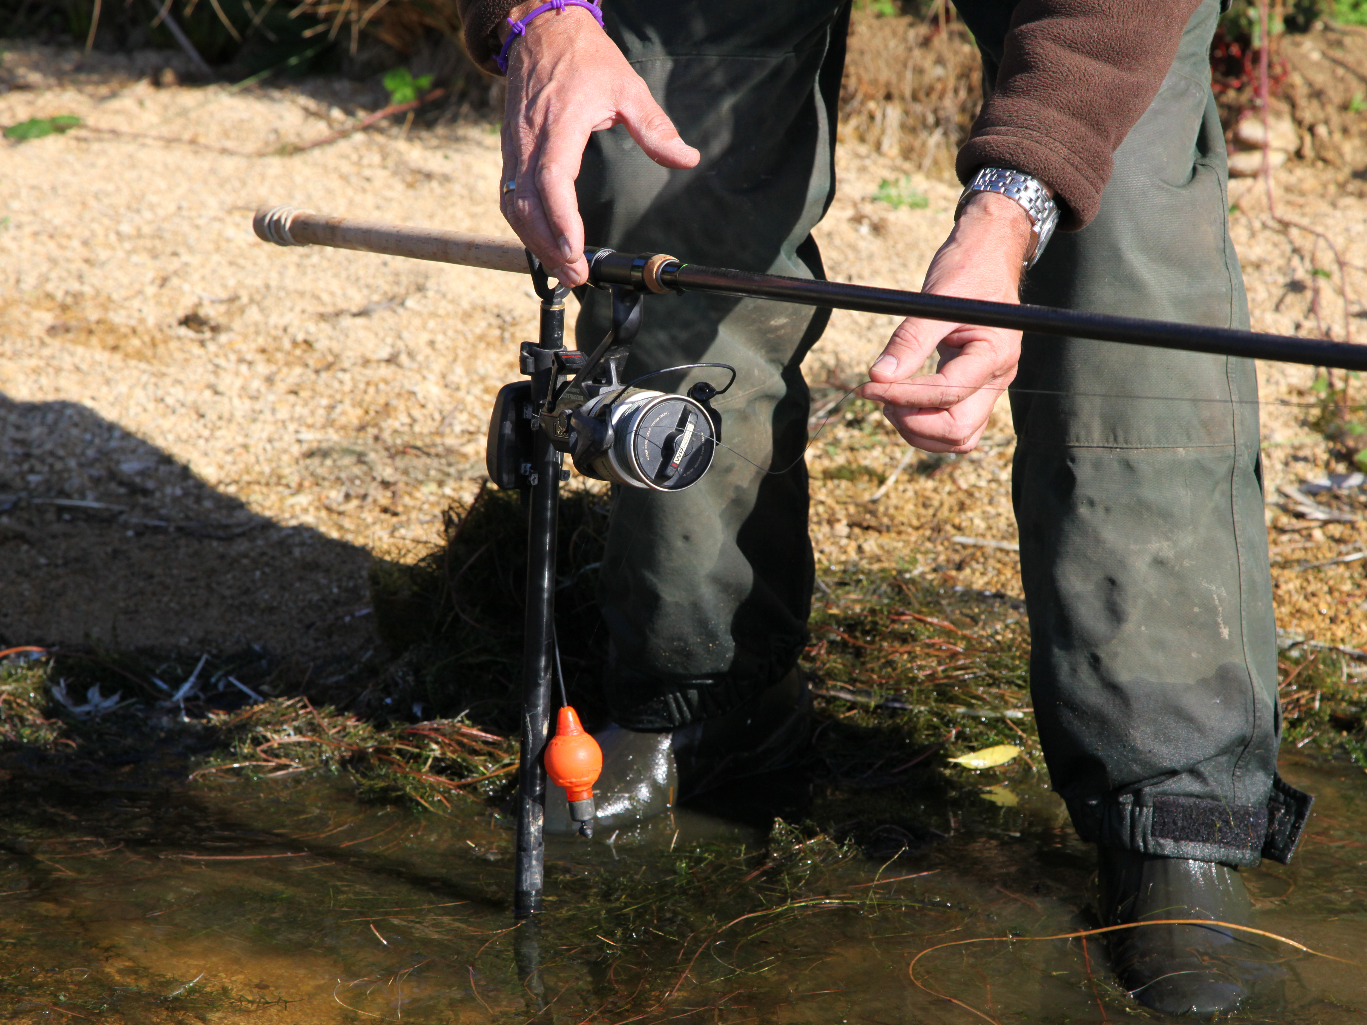

Slide 36
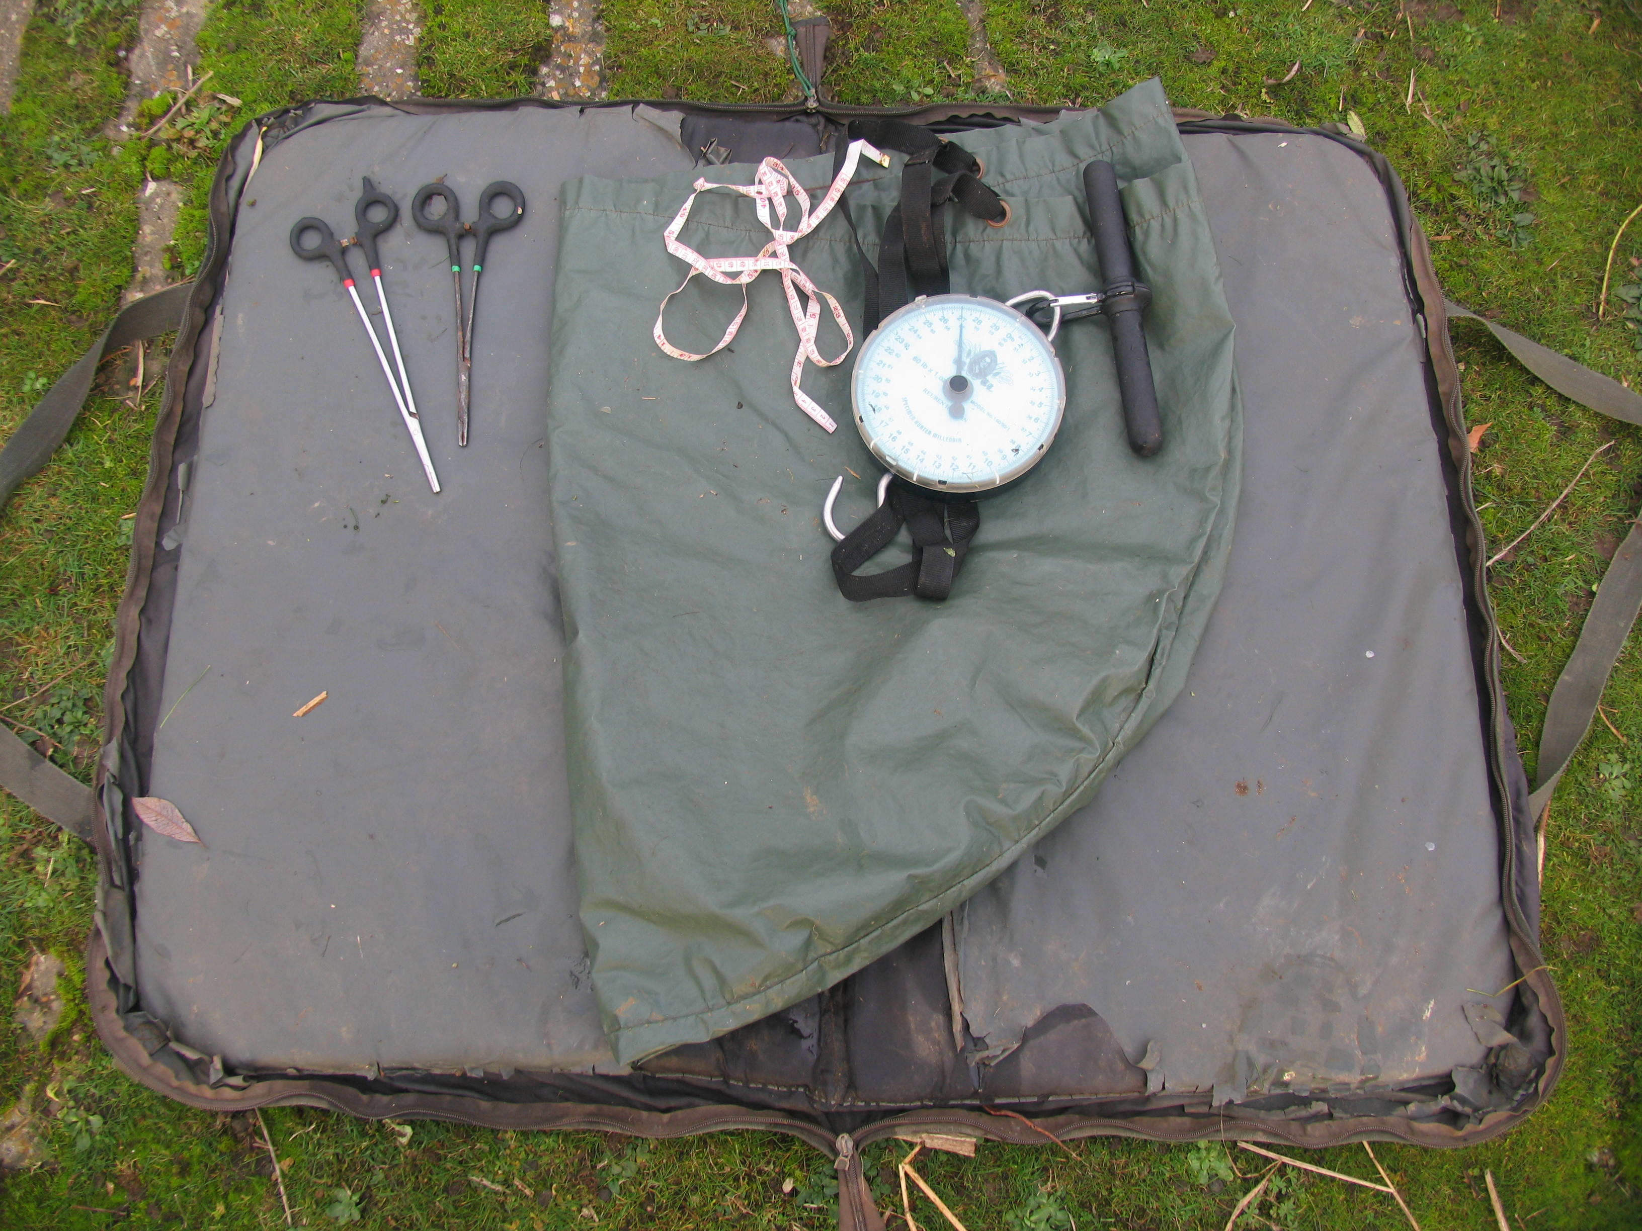

Slide 37
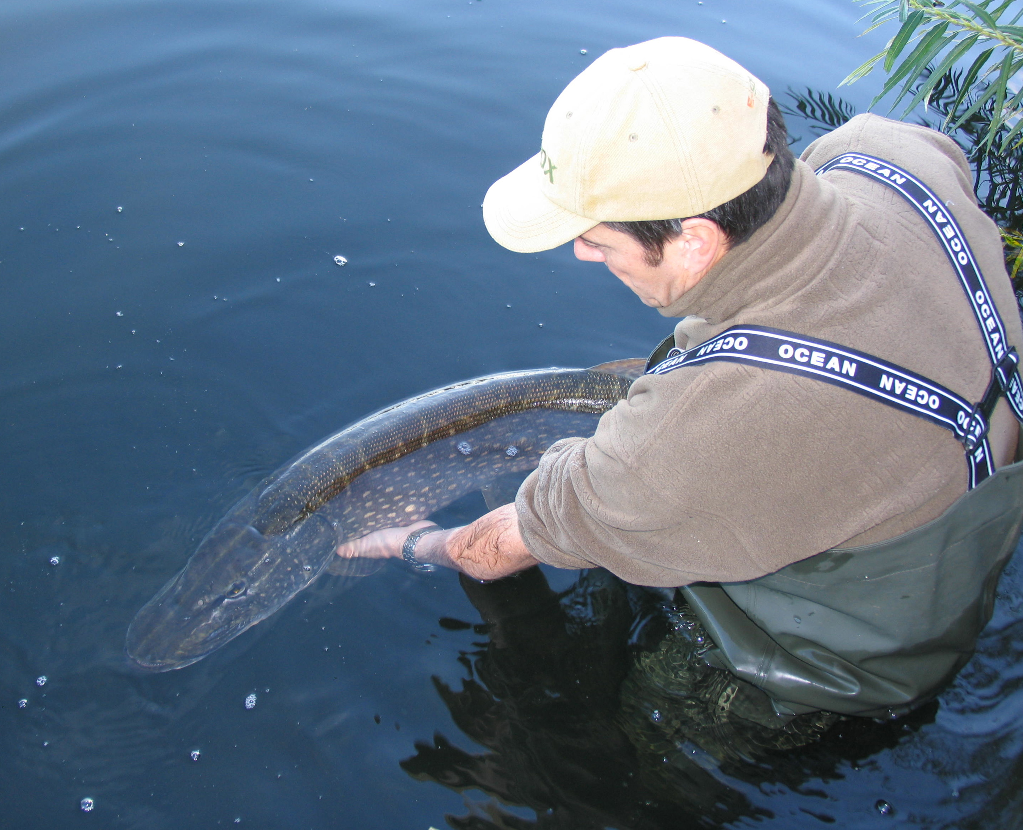

Slide 38
Summary
Eradicate rule allowing any pike to be killed.
Promote Catch & Release on all waters in Finland.
Educate Guides.
Promote code of conduct.
Ban Lip Grips

Slide 39
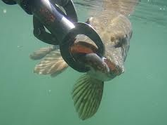

Slide 40
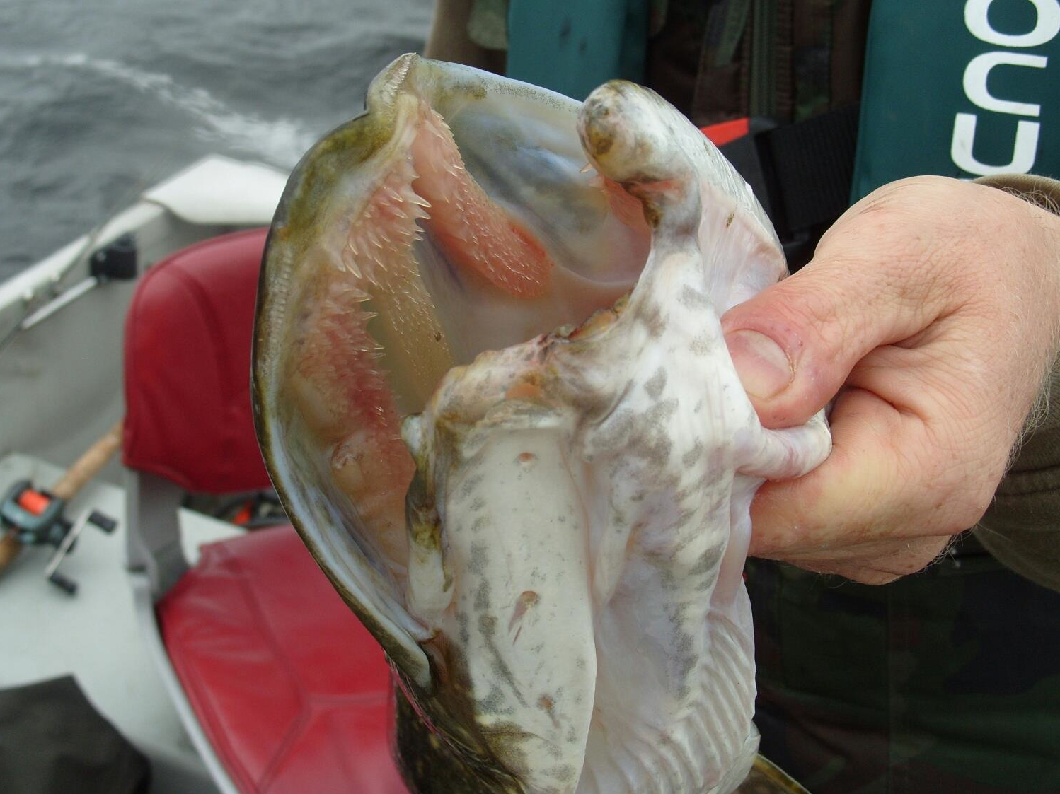

Slide 41
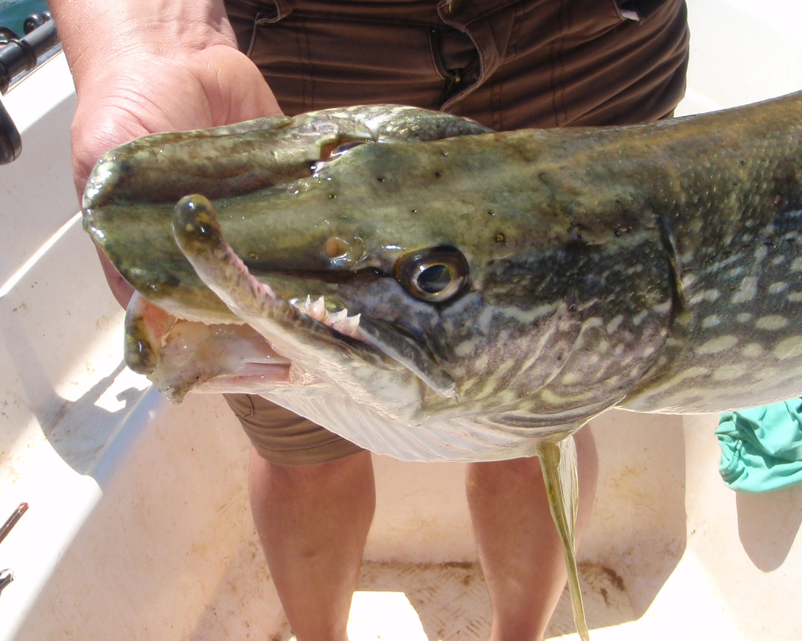

Slide 42
THANK YOU
AND
GOOD LUCK!

